Slide 1
Recursive Least Squares Adaptive Filters
Jesper Rindom Jensen, jrj@es.aau.dk
Advanced Signal Processing, Electronic Systems, Aalborg University

Slide 2
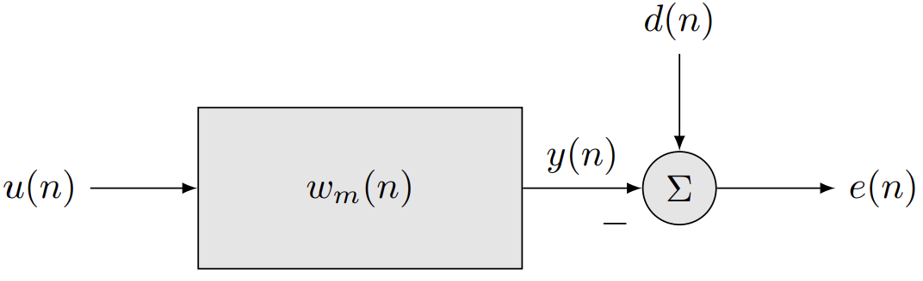
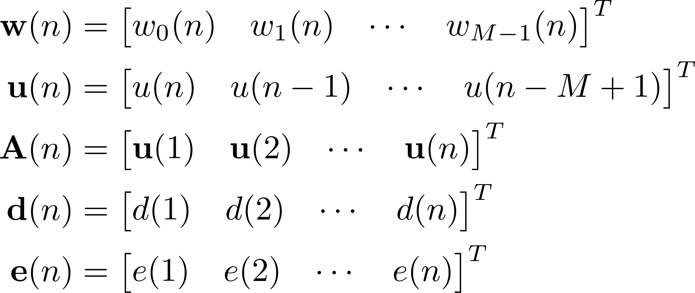
Adaptive filtering – Least Squares Solution
Consider an adaptive filter setup:
We introduce vectors containing the signal and filter values:

Slide 3
Adaptive filtering – Least Squares Solution
With the vector notation, we have that
The LS cost function can then be written as
Based on this, the optimal filter in the LS sense is
Problem: A(n) and d(n) keeps growing as n is increasing!

Slide 4
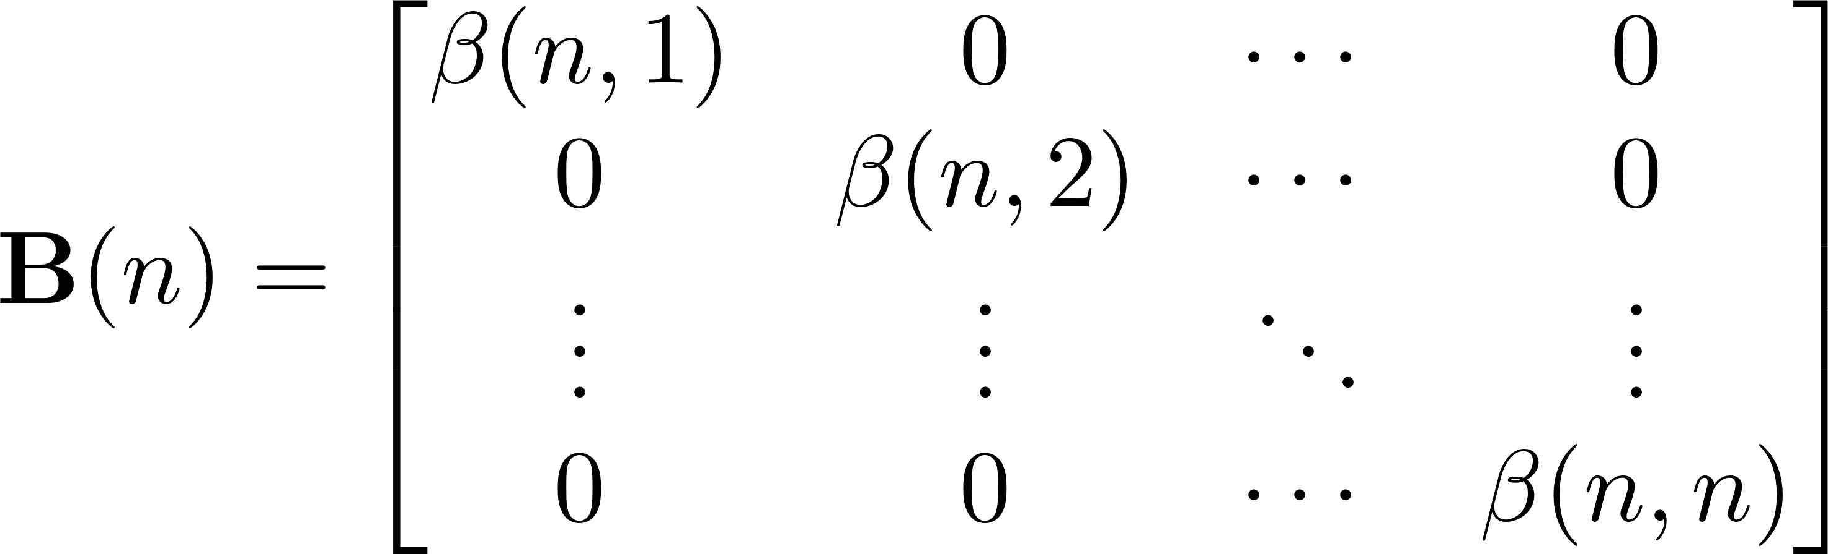
Weighted Least Squares
New data should be assigned greater weight than old data
where
Use the 5-step procedure to design the filters.

Slide 5
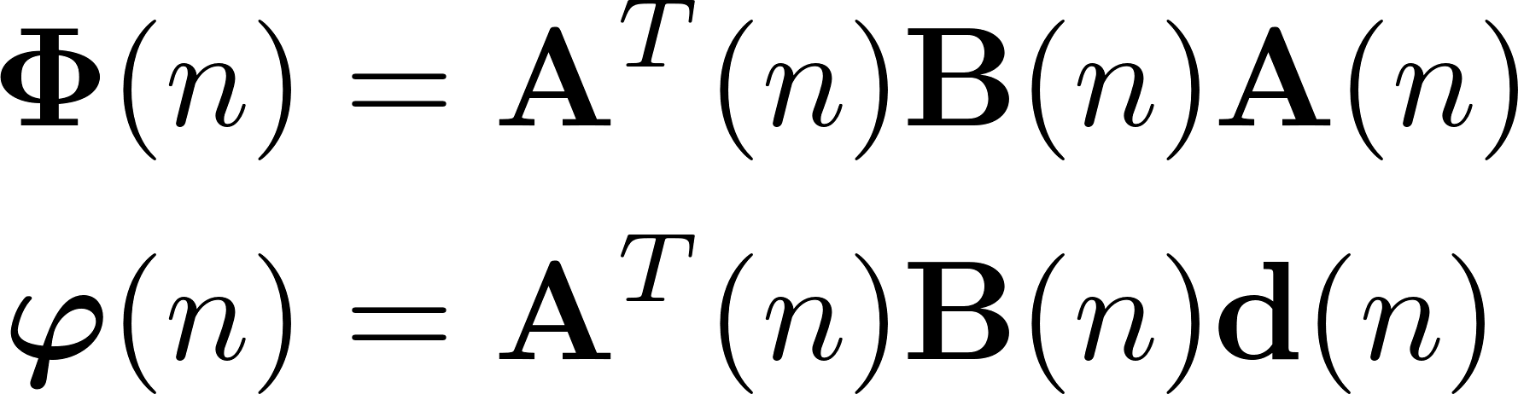


Filter design – step 1
Construct the cost function
with
We refer to and as the correlation matrix and the cross-correlation vector, respectively.
They are scaled and weighted estimates of R_{u} and r_{ud}

Slide 6
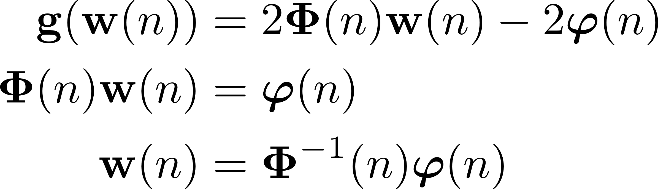
Filter design – step 2+3
Step 2: Find the gradient
Step 3: Solve g(w(n)) = 0 for w(n)
(weighted normal equations)
(if correlation matrix is invertible)

Slide 7

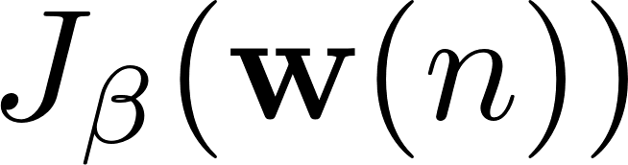

Filter design – step 4+5
Step 4: Find the Hessian
Positive definite for all w(n) if A(n) is full rank and β(n,i) > 0 for all n ≥ i > 0.
Step 5: Implication
is a convex function, and
is the global minimiser
Solution (w_{o}(n)) often referred to as WLS solution.

Slide 8
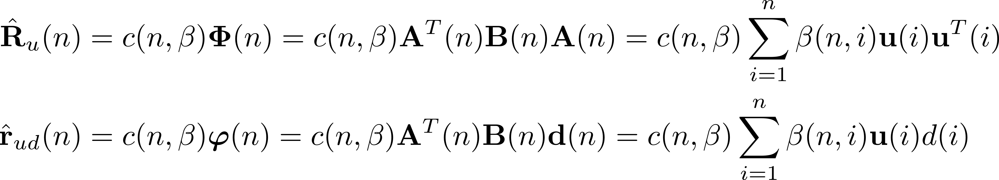
Estimation of the (Cross-)Correlation
Comparing weighted normal equations and Wiener-Hopf equations:
Constant c(n, β) depends on n and weighting β(n,i).
Can be selected so the (cross-)correlation estimates are unbiased

Slide 9
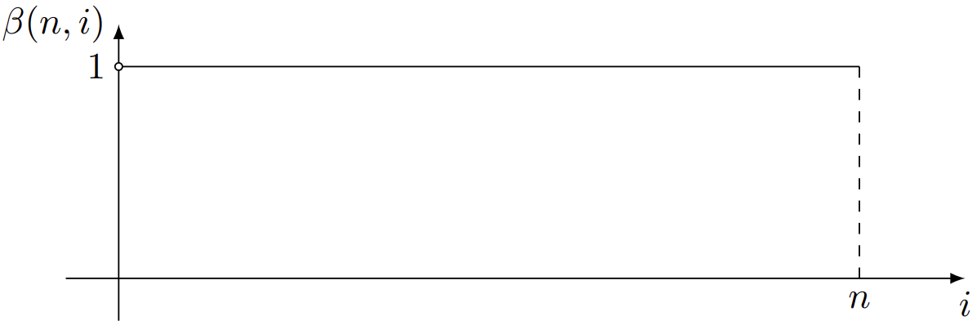
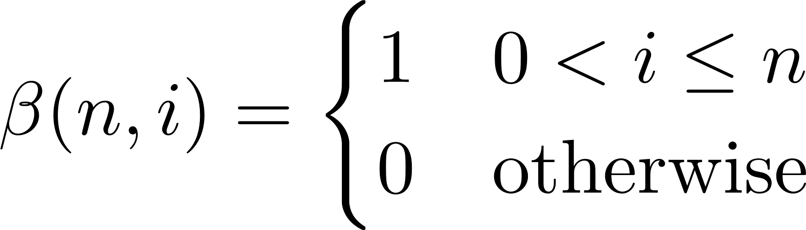
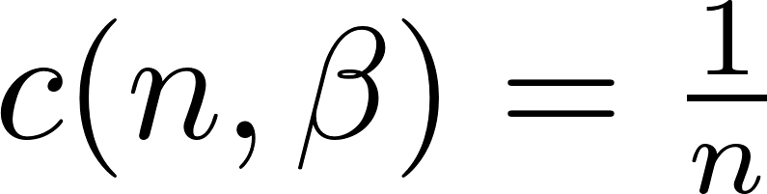
Growing Window Weight Function
The growing window weight function
Reduces WLS to the standard LS problem.
In order to obtained unbiases estimates of R_{u}(n) and r_{ud}(n):

Slide 10
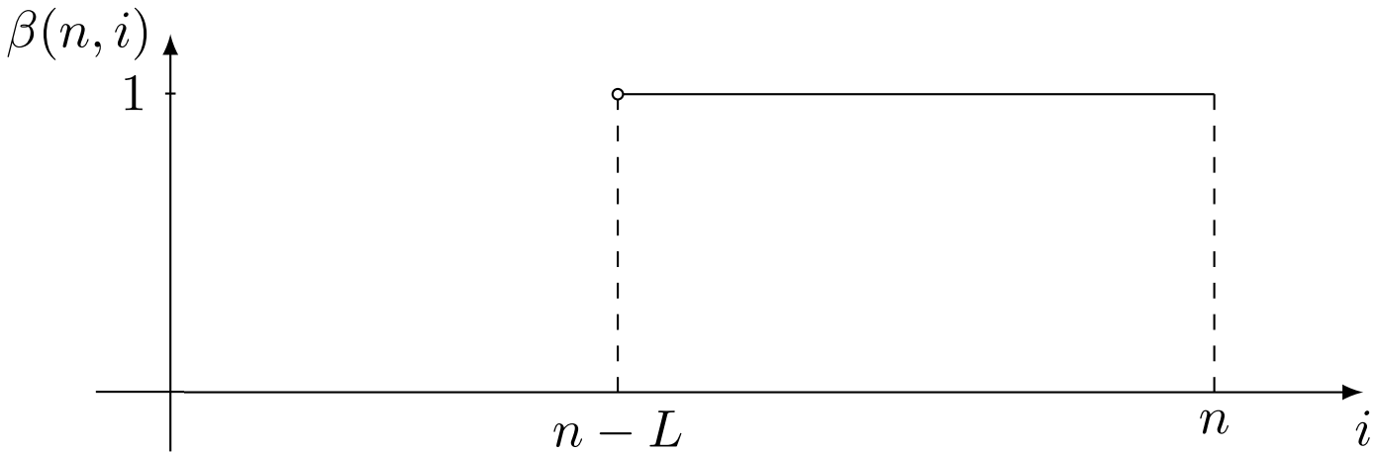
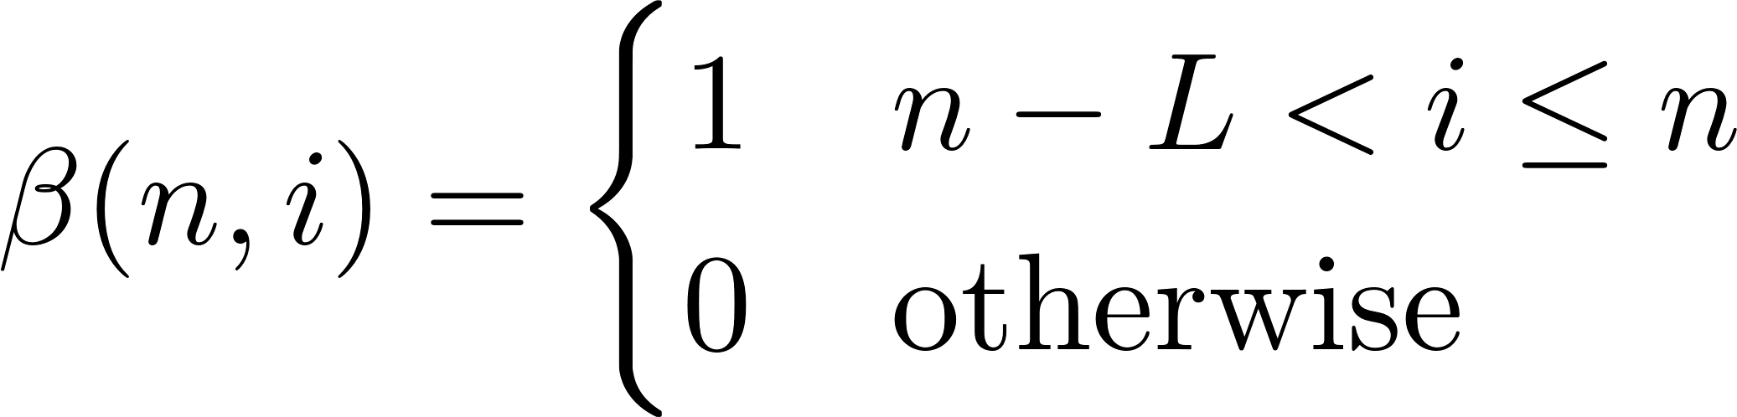
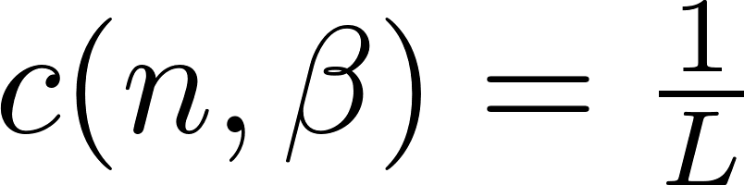
Sliding Window Weight Function
The sliding window weight function:
Selecting L = n, the sliding window reduces to the growing window.
In order to obtained unbiases estimates of R_{u}(n) and r_{ud}(n):

Slide 11
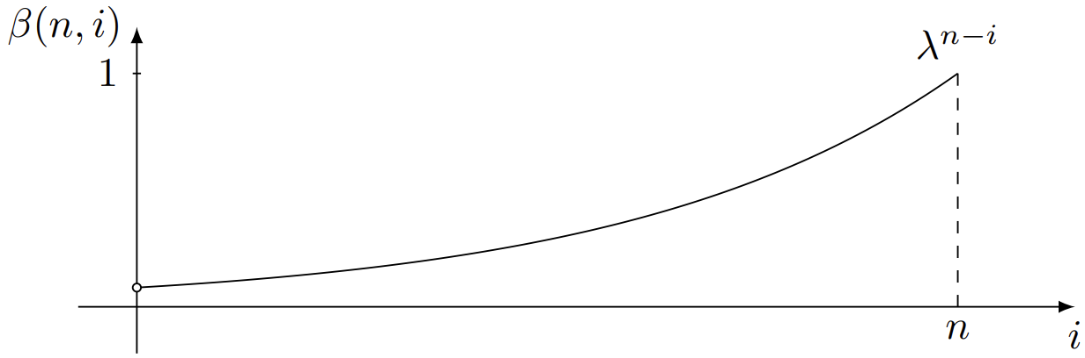
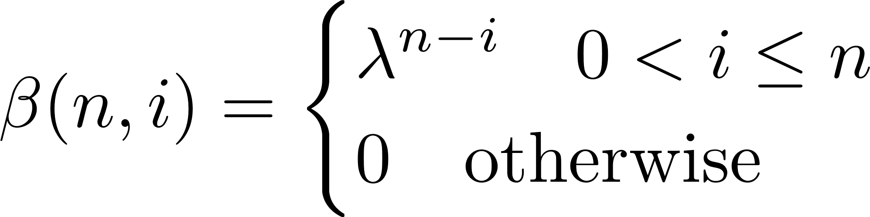
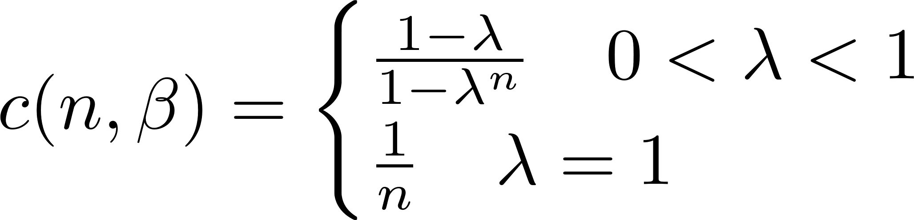
Exponential Weight Function
The exponential window weight function:
If we select λ = 1, the exponential window reduces to the growing window.
In order to obtained unbiases estimates of R_{u}(n) and r_{ud}(n):

Slide 12



Recursive Least-Squares Algorithm (Exponential Weight Function)
In an online algorithm, we solve the weighted normal equations for every time index n
Direct solution:
Computationally complex since:
A(n), B(n), and d(n) grows with n ➔ direction solution infeasible without finite window.
Complexity scales cubically with filter order:
RLS algorithm solves both problems!

Slide 13
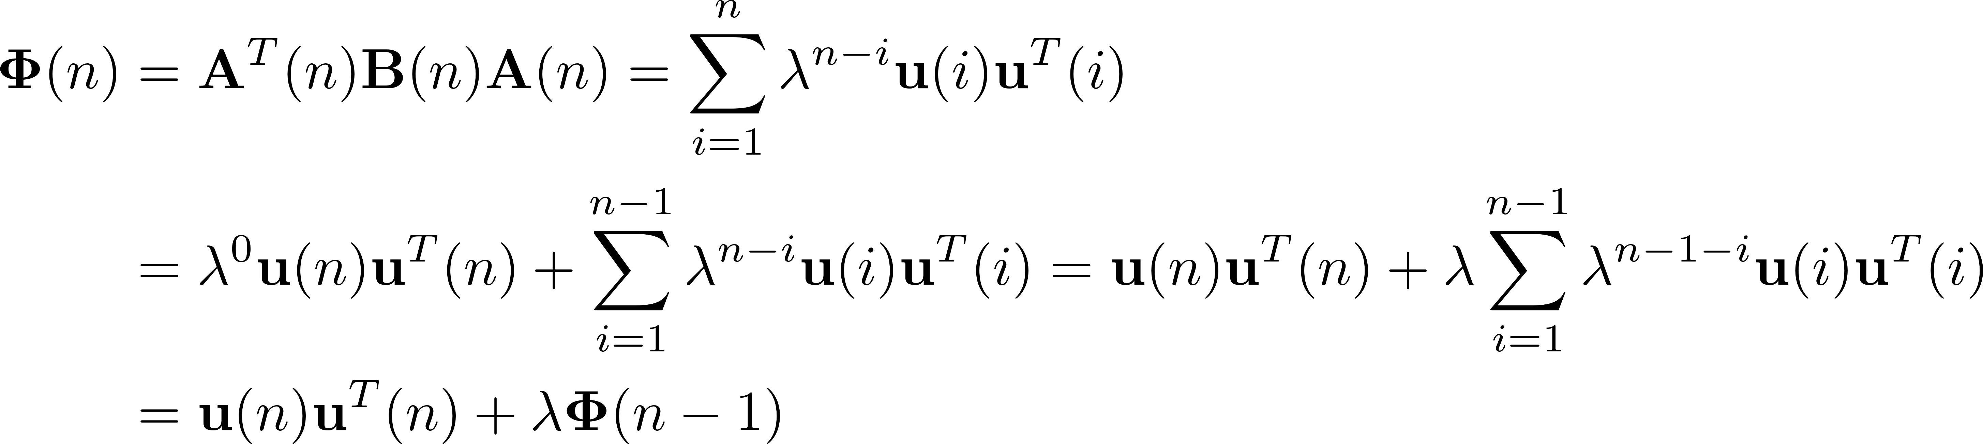
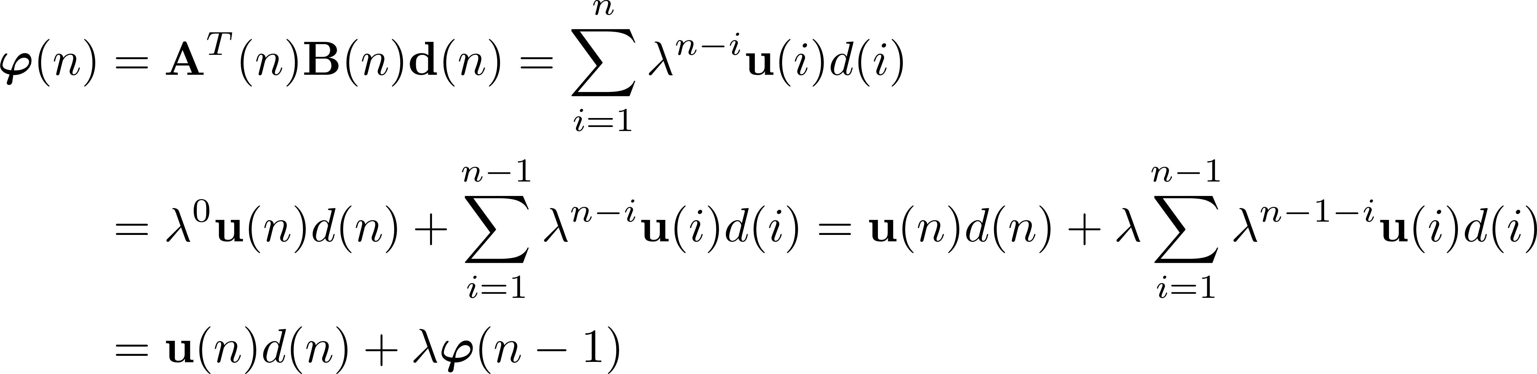
Recursive Computation of (Cross-)Correlation
(Cross-)correlation estimates can be recursively updated by rewriting:
Reduced computational complexity!

Slide 14
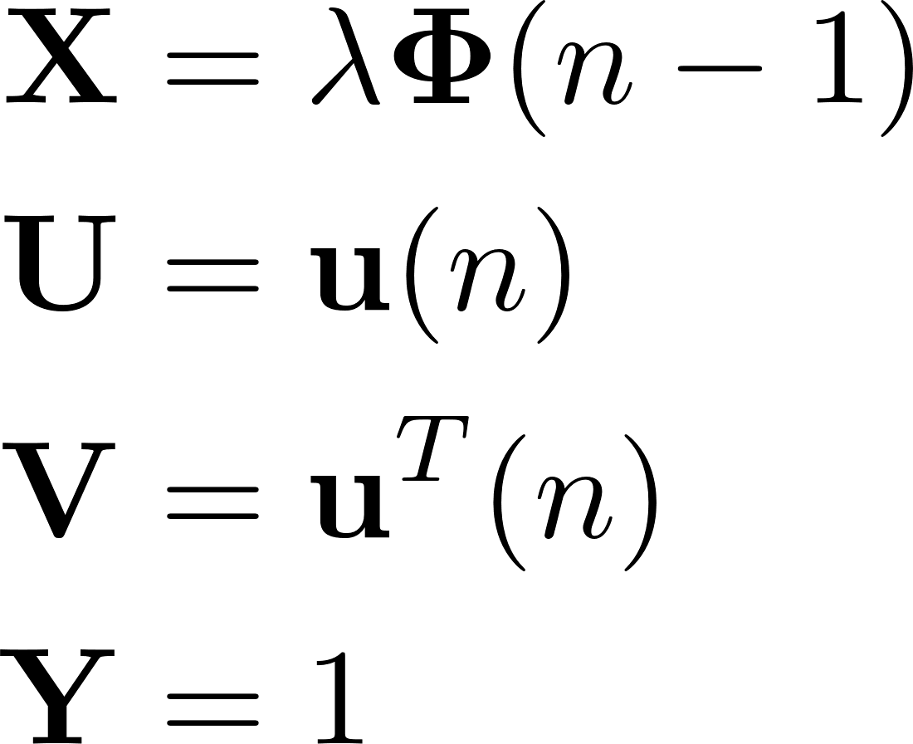
Inversion of Correlation Matrix
Matrix inversion lemma (MIL)
By choosing…
and invoking the MIL on the recursive update equation, we get…

Slide 15
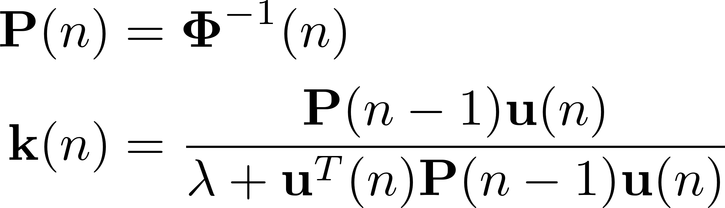
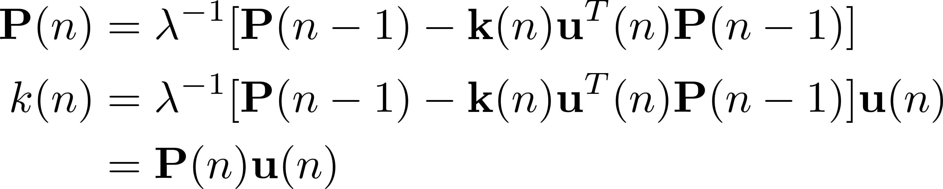
Simplifying notation
By introducing the notation…
we may rewrite the recursive update of the inverse correlation matrix…

Slide 16
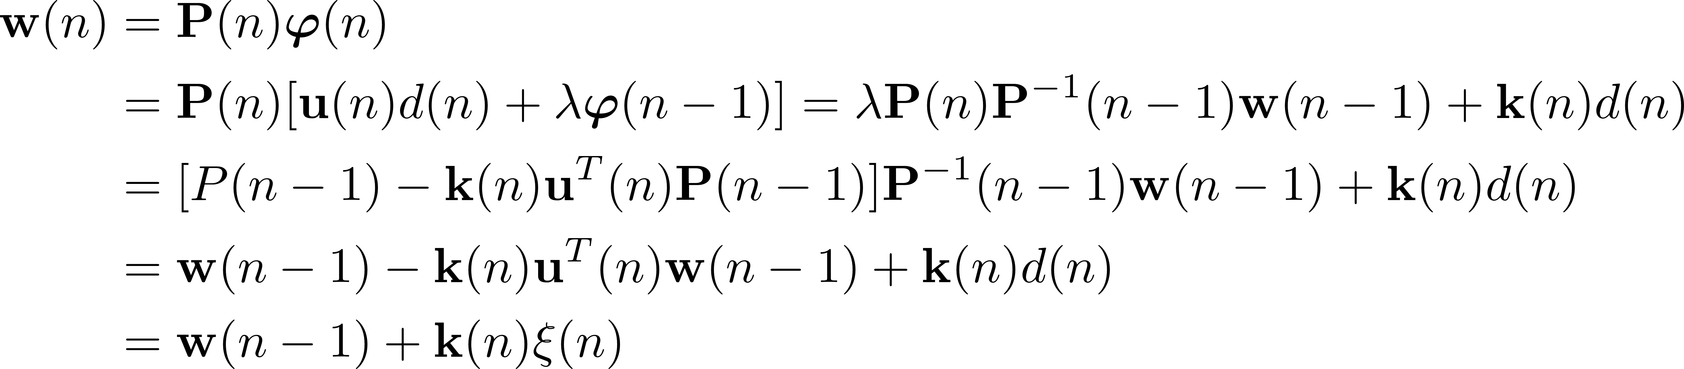
Recursive Filter Update
From here, we can develop the recursive filter update as…
where the a priori error is defined as…

Slide 17
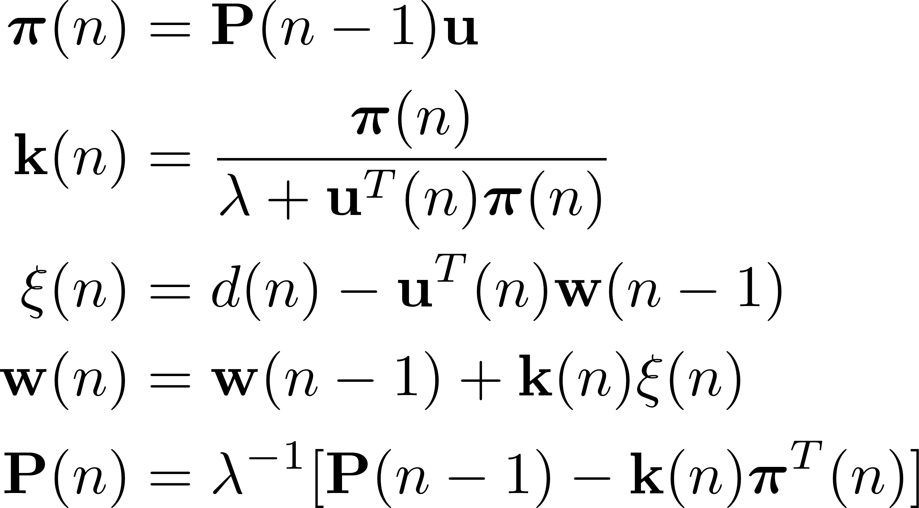
The RLS Algorithm
Based on this, we can formulate the RLS algorithm:
Requires O(M²) operations to run one iteration for M-tap FIR filter.

Slide 18
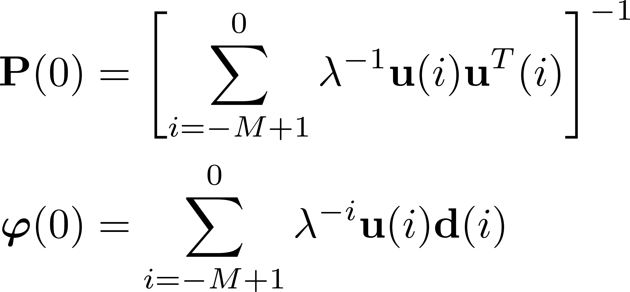
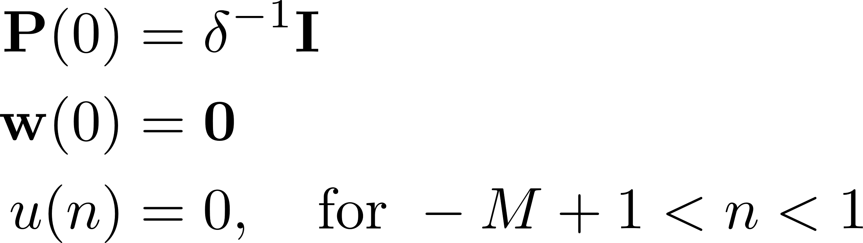
Initialization
Biased (decreasing bias for large n):
Unbiased (requires knowledge of future samples):

Slide 19
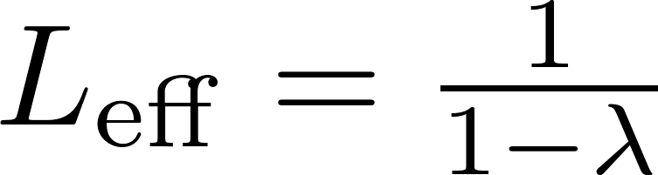
Forgetting Factor vs. Window Length
The forgetting factor can be interpreted as a window length:
For 0 < λ < 1, this leads to…
Thus, we have that…

Slide 20
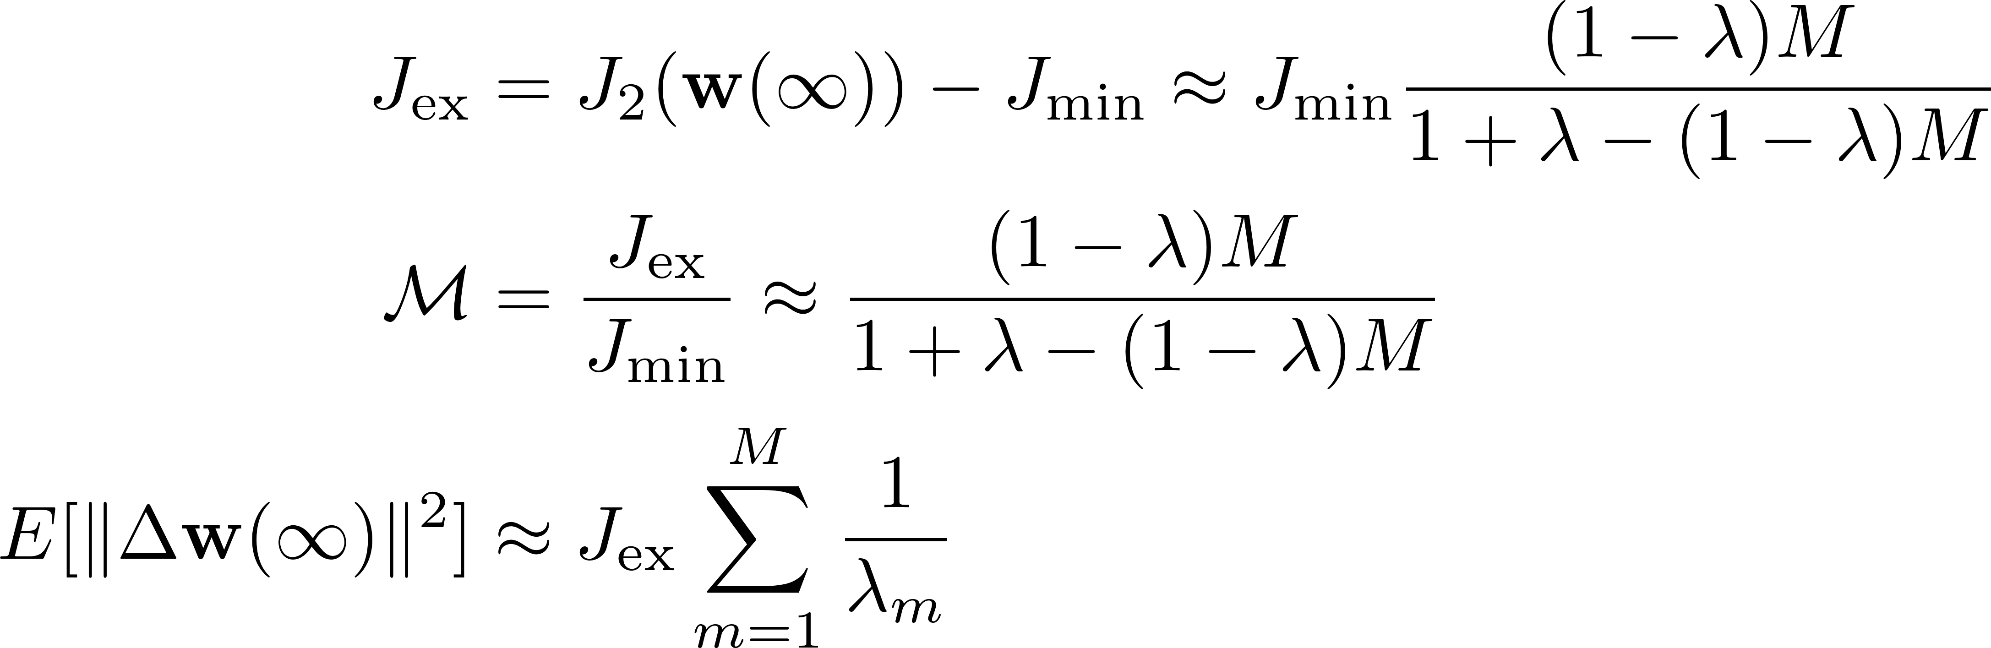
Steady-State Analysis
It can be shown that…
(EMSE)
(Misadjustment)
(MSD)

Slide 21
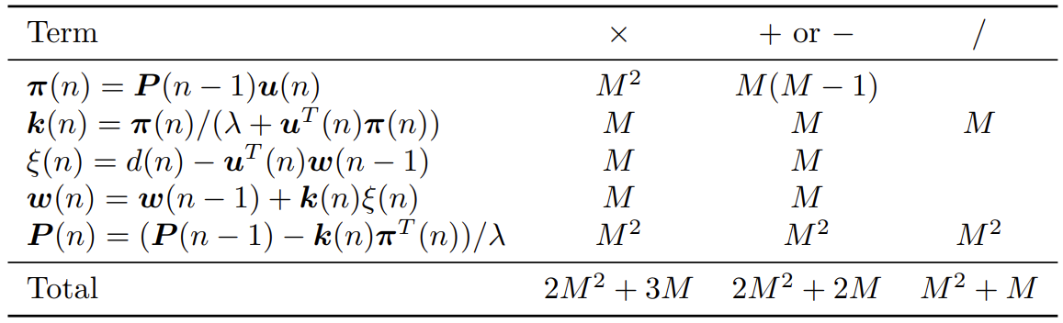
Computational Cost
Breakdown of the computational cost of the RLS algorithm

Slide 22
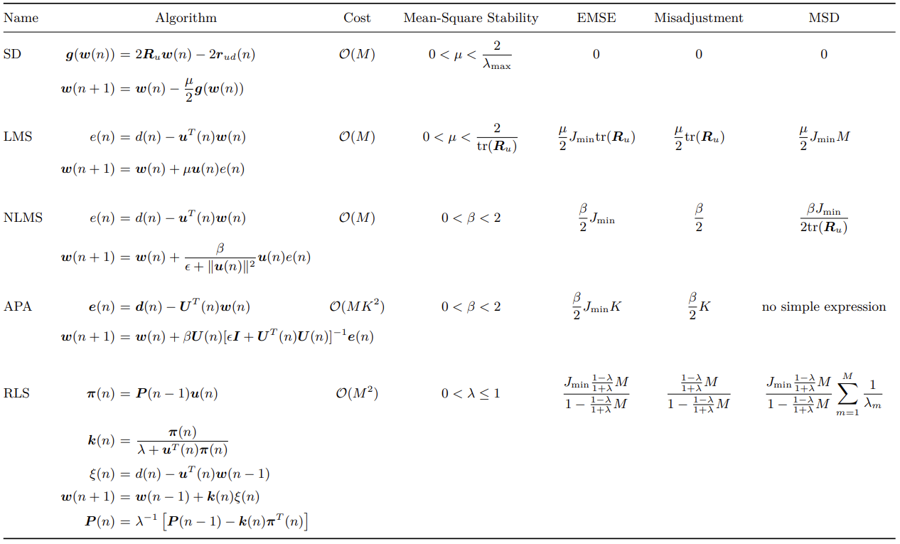
Basic Adaptive Filtering Overview

Slide 23
Exercise 1
Consider a situation, where you are listening to music in an environment with background noise. Luckily you have placed a microphone, which is able to pickup the background noise. Your job is now to design a filter, which can remove a significant part of the background noise from the noisy music.
Implement and compare the performance of LMS, normalised LMS and RLS
To get inspiration you can look at the MATLAB file Filters.m which provides an example solution.

Slide 24
Exercise 2
Implement an RLS algorithm for system identification of a stationary signal. Play around with forgetting factor and filter orders. To get inspiration you can look at the MATLAB file sys_rd_rls.m which provides an example solution.

